Slide 1

Bus guide and location reminder system
Project Co-Supervisor
Muhammad Masud Tarek
Assistant Professor
Computer Science & Engineering
State University of Bangladesh
Project Members
1. Arefin Newaz Prince
ID: UG02-29-12-035
2. Hemendra Rupak Biswas
ID: UG02-29-12-026
3. Rashedul Karim
ID: UG02-29-12-030
Project Supervisor
Dr. Bilkis Jamal Ferdosi
Head of the Department
Computer Science & Engineering
State University of Bangladesh

Slide 2
introduction
This is an android application that uses the Google Maps Android API v2. It will help user to find suitable bus form current to desired location and also they can make upcoming schedule of journey. This app will notified user when he/she arrive at or leave a specified destination which set by the user. User can make schedule by typing or selecting location in the map. The app then keeps an eye on the GPS information collected by user’s smartphone to trigger the alert when user arrive at or leave a destination.
This app will also share current location with user’s circle for emergency purpose or when the user want to share it.

Slide 3
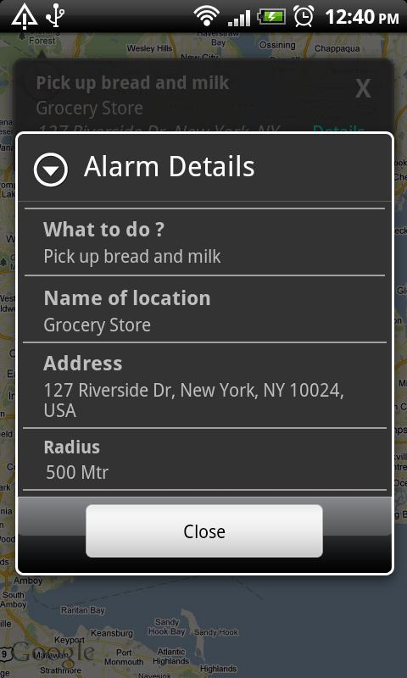
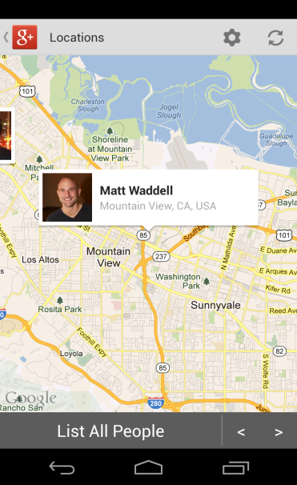
Project Overview
Tracking User’s own location and nearby bus stopes.
Easier to select bus where he/she has to go and can calculate time and distance.
User can observe real time movement.
Notified the user when he/she reach the nearest/desired scheduled destination.
Can detect nearest paired device.

Slide 4
Project Benefits
By this app user can’t miss scheduled tasks/events in any location.
It will provide proper bus guide for known and unknown city.
User can see number of busses existing in desired path.
It can also calculate time and provide real-time movement.
A device can find the location of another pair’s.

Slide 5

Features
Location to location bus instructions.
Finding nearest bus stopes.
Set Location/schedule Alert.
Making Pair and find nearby paired devices.
It uses less amount of data and memory.
Easier to operate for any kind of user.

Slide 6




Methodology
Required Tools :
Coding editor : Eclipse
Designing language : Java
Styling language : XML
Database language : SQLite
Web Server : Xampp
Operating system : Android

Slide 7
Gantt Chart
Task | Jan | Feb | March | April
System proposal
Analysis & Documentation
App wire framing
App design
Database design
Input design
Output design
Release V1
Report writing & Final Submission

Slide 8
Thank You

